Slide 1
MindDrivers
Разработчик DL Жуков Егор
Разработчик DL Никитин Андрей

Slide 2
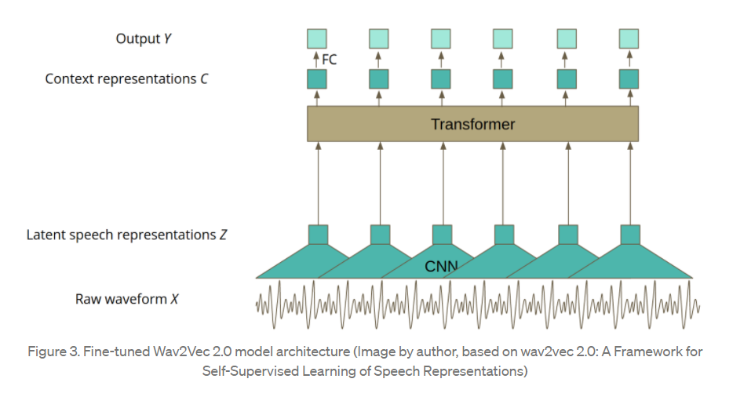
Wav2Vec2
https://arxiv.org/pdf/2006.11477.pdf

Slide 3
Pipeline Fine-Tuning Pre-train model
https://github.com/huggingface/notebooks/blob/master/examples/audio_classification.ipynb

Slide 4
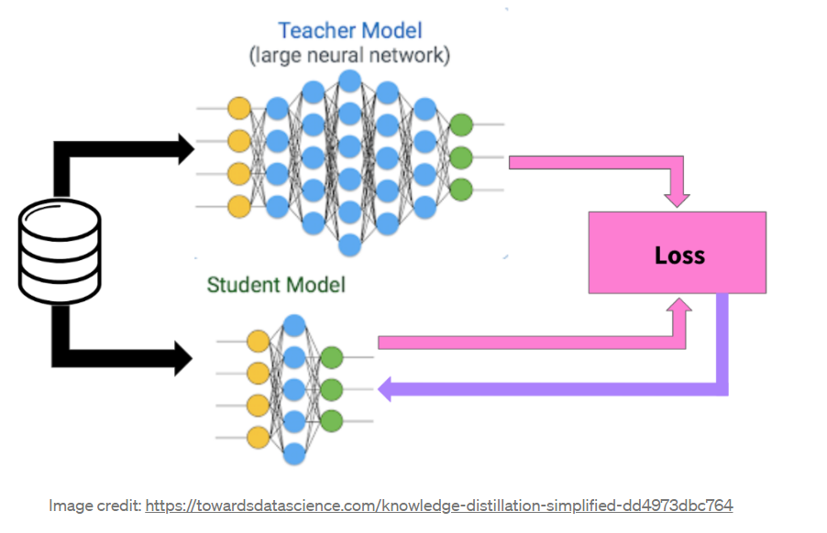
Compressing Wav2vec 2.0

Slide 5
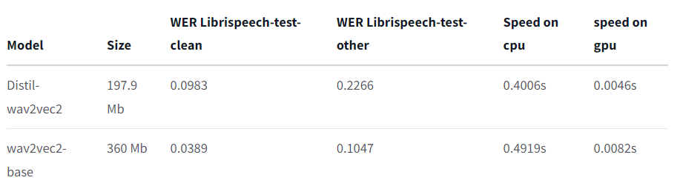
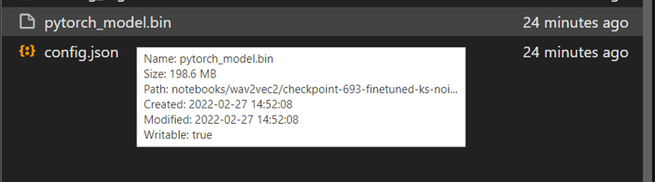
Distil-wav2vec2
https://huggingface.co/OthmaneJ/distil-wav2vec2

Slide 6
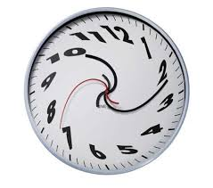

Possible improvements
Augmentation data ->
Denoiser with pre-train models ->

Slide 7
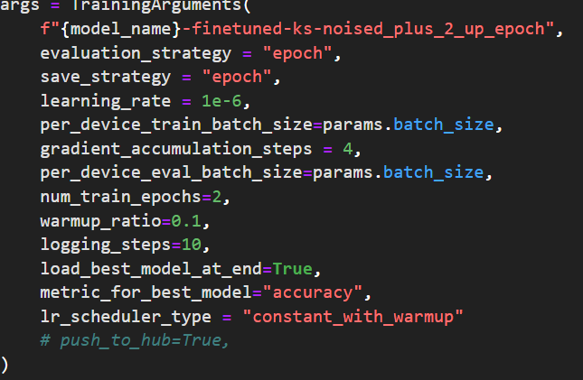
Train plan
10 epochs: lr 3e-5
2 epochs: lr 1e-5
2 epochs: lr 1e-6

Slide 8

Best Results

Slide 9
Contacts
Егор Жуков
bit.zhukov@gmail.com
https://t.me/egor_zhukov_ai
Андрей Никитин
small.ant.82@gmail.com
https://t.me/asnikitin

